Slide 1



www.beauroi.com
Employee Performance Dashboard
Beau Roi Technologies Private Limited
Bhavan Kumar S
30 July 2025

Slide 2
PROJECT OBJECTIVES
OUR AIM:
To develop an interactive and data-driven dashboard that enables HR and managers to monitor, analyze, and enhance employee performance through real-time visualization of key performance indicators.

Slide 3
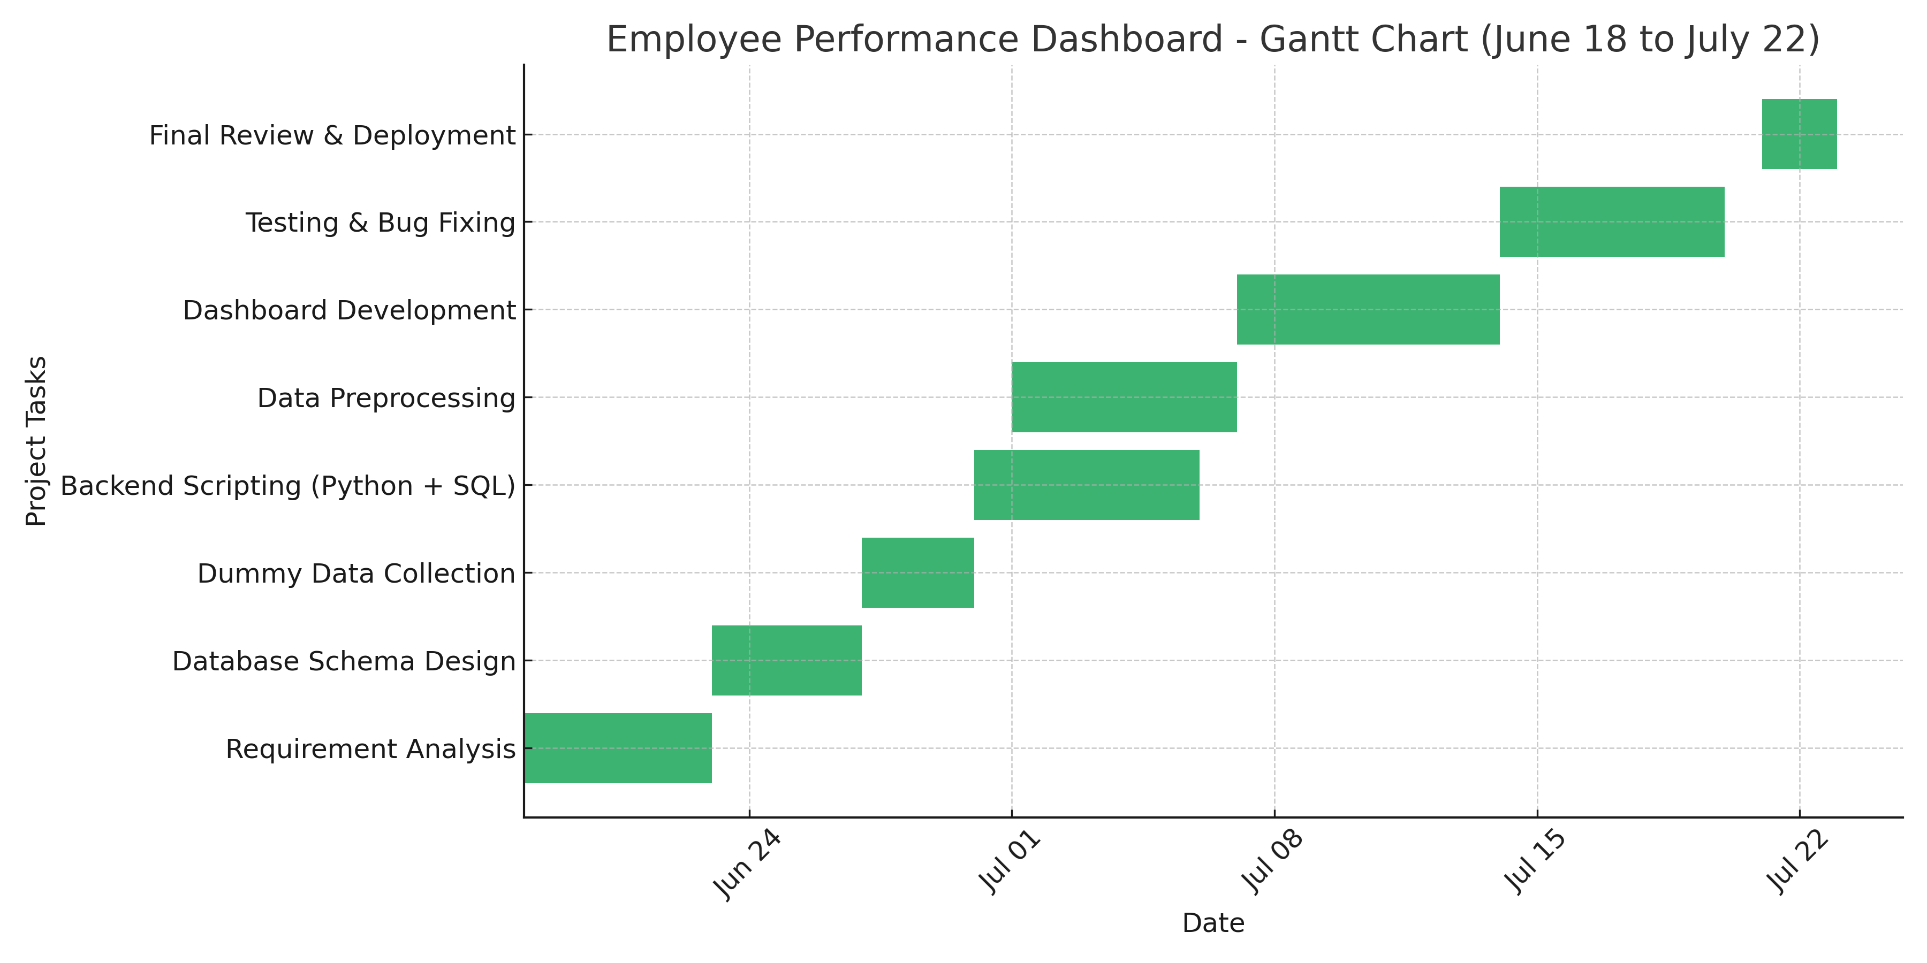
PROJECTED PLAN
Weekly
Gantt
Chart
To systematically plan, develop, and deploy the Employee Performance Dashboard through phased monthly milestones.

Slide 4
PROJECTED PLAN
Define Project Scope: Develop a data-driven dashboard to visualize employee performance metrics like KPI scores, attendance, and appraisal ratings.
Identify Stakeholders: Understand HR managers’ and team leaders’ expectations in analyzing employee performance and making data-driven decisions.
Requirement Gathering: List required performance indicators, departments, data filters, chart types, and expected outputs.
Tech Stack Finalization: Decide on Python (Data Analysis), MySQL (Database), Pandas/NumPy (Data Processing), Streamlit or Dash (Dashboard).Design database schema: tables for employees, KPIs, attendance, and appraisals.
PHASE 2
Dashboard Integration: Embed processed data and charts into the dashboard interface using Streamlit or Dash.
Interactivity Testing: Test filters (by department, year, performance level), refresh buttons, dropdowns, and summary views.
Functionality Check: Ensure database connection, chat loading and UI components work properly.
Debugging & Fixes: Fix issues related to chart scaling, missing data handling, or layout responsiveness.
PHASE 4
PHASE 1
PHASE 3
Planning & Requirement Analysis
System Design & Development
Database Design & Connection: Create MySQL tables and connect to Python using mysql.connector or SQLAlchemy.
Dummy Data Generation: Generate a realistic dummy dataset covering departments, KPI scores, attendance records, and appraisal scores.
Data Preprocessing: Clean, filter, and structure data using Pandas. Handle missing values and prepare grouped statistics.
Dashboard Design: Plan layout (filters, charts, summary section). Choose static (Matplotlib/Seaborn) and interactive (Plotly/Altair) chart types.
Integration & Testing
Deployment & Presentation
UI Enhancements: Improve layout with styling (Streamlit themes or CSS in Dash), use clear fonts, and align charts and filters neatly.
Final Compilation: Ensure all features are working, comments are added to code, and project folder is structured for submission.
Video Output & Demo: Record a walkthrough video of the dashboard showing filter use, charts, and insights.
Project Presentation: Prepare a PPT and present the project flow, tech stack, dashboard output, and use case to the team leader.

Slide 5
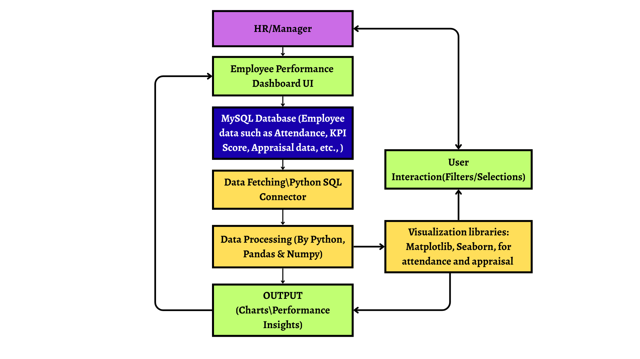
ARCHITECTURE DIAGRAM
EMPLOYEE PERFORMANCE DASHBOARD

Slide 6
WORKFLOW
WORKFLOW PROCESS:
1. Requirement Analysis: Identified HR needs to track employee performance through KPIs, attendance records, and appraisal ratings. Finalized functional and visual requirements for the dashboard.
2. Database Schema Design: Designed normalized MySQL tables for Employees, Departments, KPI_Scores, Attendance, and Appraisals. Established foreign key relationships and sample dummy data.
3. Backend Setup & Data Connection: Connected Python with MySQL using mysql.connector. Fetched and updated employee performance data securely for analysis and visualization.
4. Data Preprocessing (Pandas/NumPy): Cleaned and transformed data, handled missing values, and prepared performance summaries such as monthly trends, average scores, and department-level stats.
5. Dashboard Development (Streamlit/Dash): Created an interactive dashboard layout including filters (by department, year), search bars, and visualization areas using Streamlit or Dash framework.
6. Chart & Module Implementation: Built visual modules using Matplotlib, Seaborn, and Plotly for KPI trends, attendance rates, appraisal distribution, and performance comparisons.
7. Testing & Bug Fixing: Verified database connections, filter functionality, and chart rendering. Resolved layout, UI responsiveness, and data refresh issues.
8. Deployment & Compilation: Finalized the project with a video walkthrough. Prepared for local or cloud deployment and created a presentation for mentor/team leader review.

Slide 7
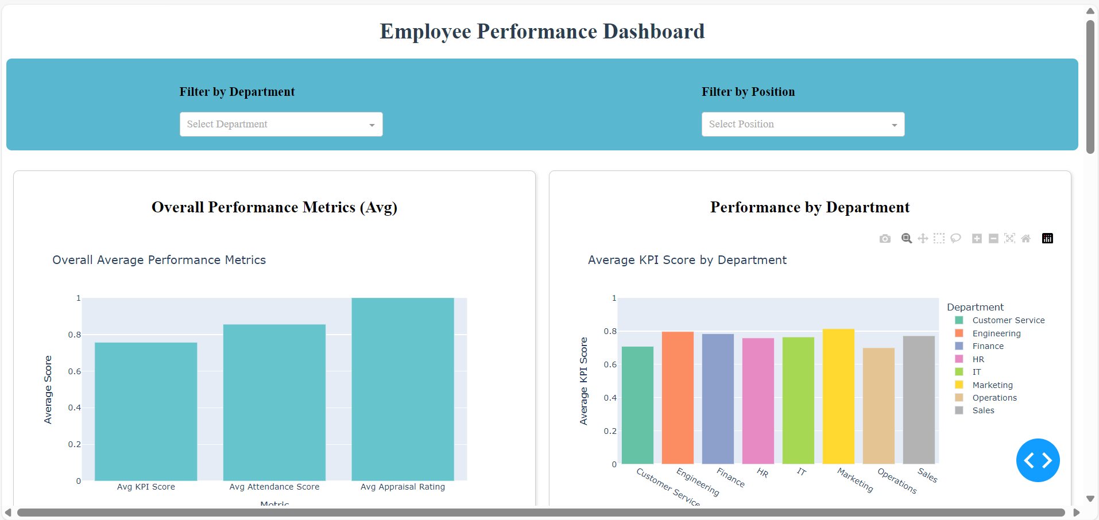
RESULTS
Dashboard Overview – Employee Performance Summary

Slide 8
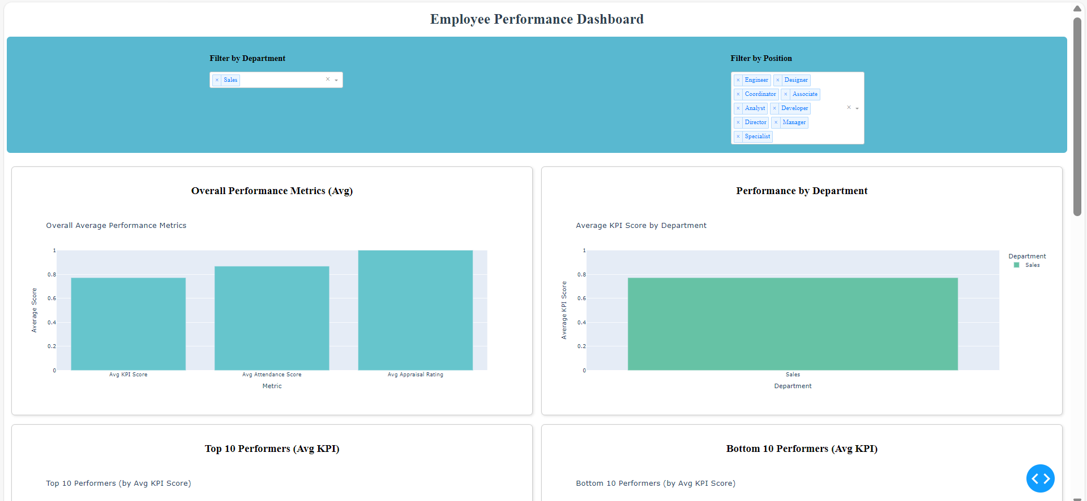
RESULTS
Department-Wise Performance Distribution

Slide 9
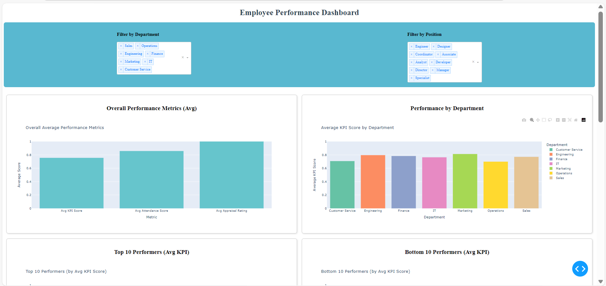
RESULTS
Appraisal Tracker – Past vs Current Ratings

Slide 10
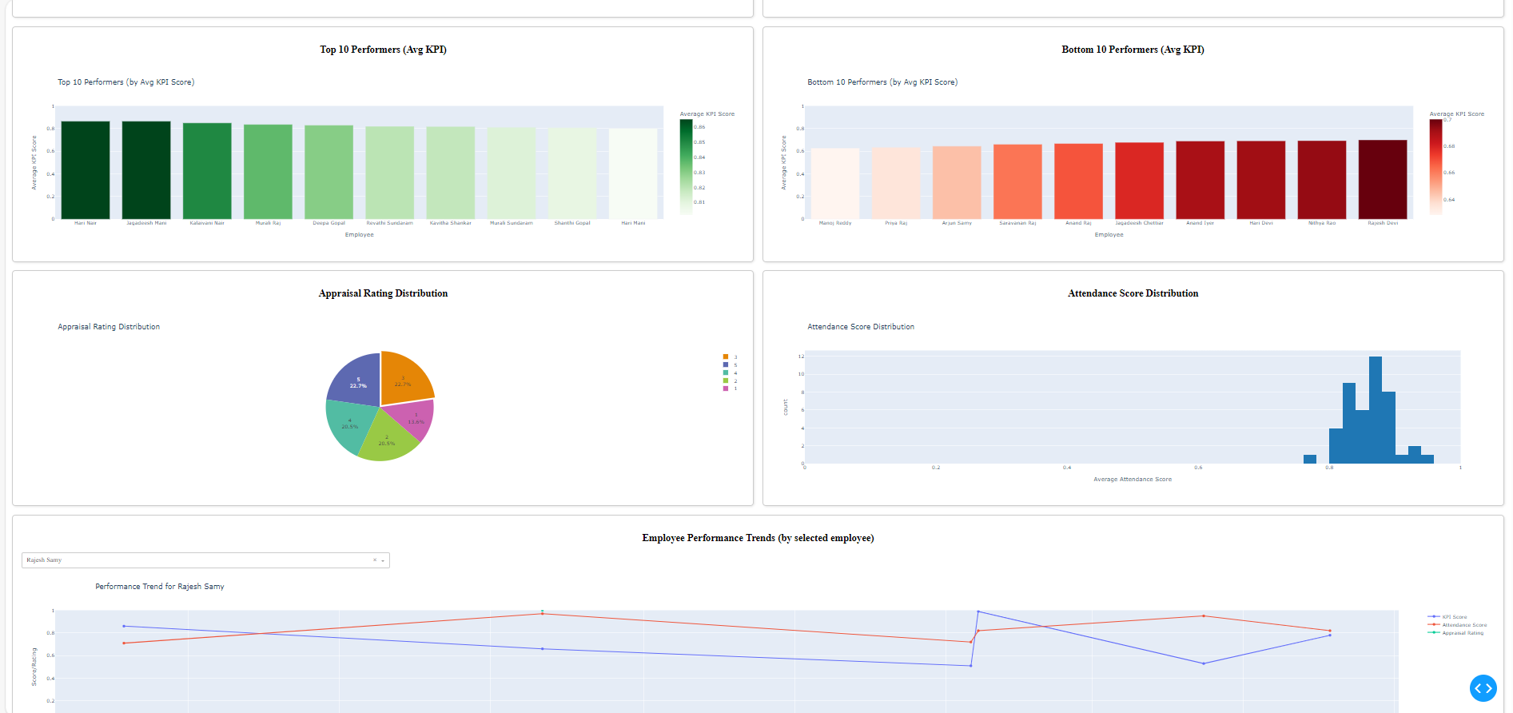
RESULTS
Interactive Filters – View by Department, Month, and Role

Slide 11
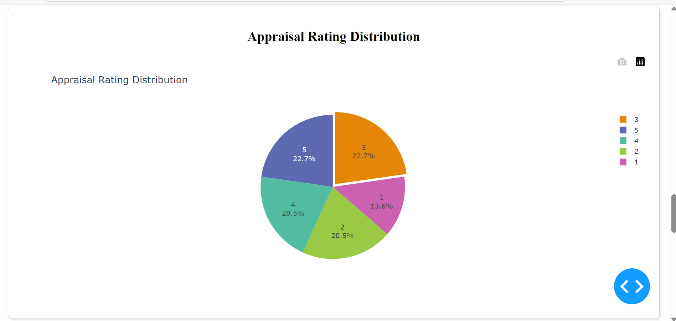
RESULTS
Appraisal Rating Distribution

Slide 12
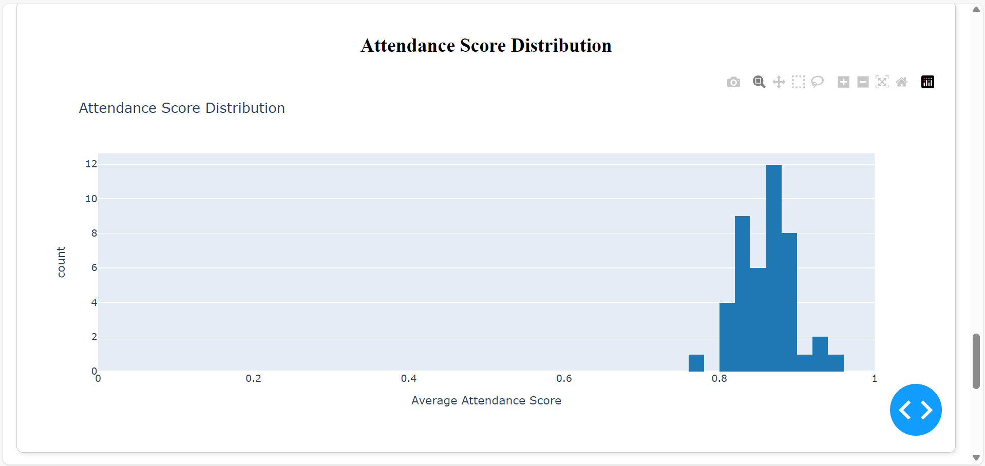
RESULTS
Attendance Score Distribution

Slide 13
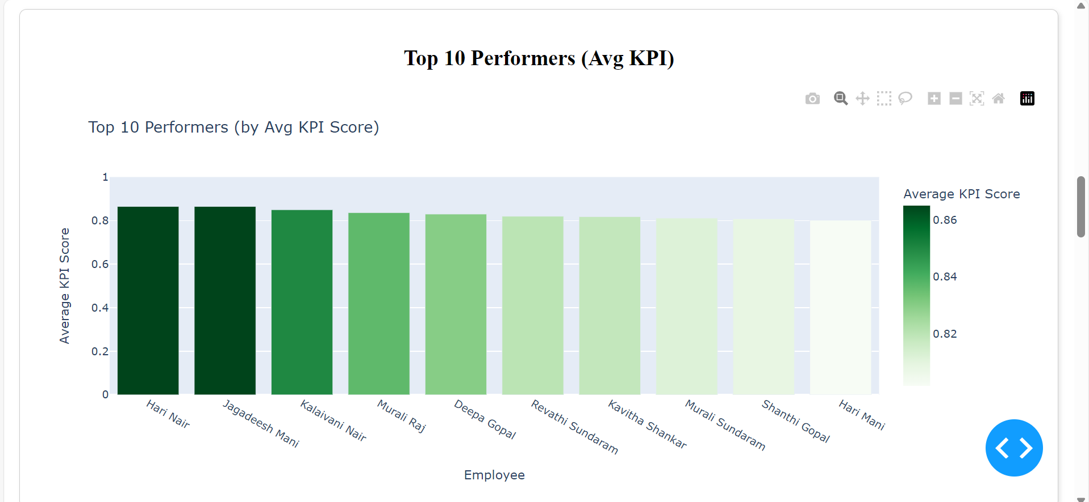
RESULTS
Top 10 Performers (Avg KPI)

Slide 14
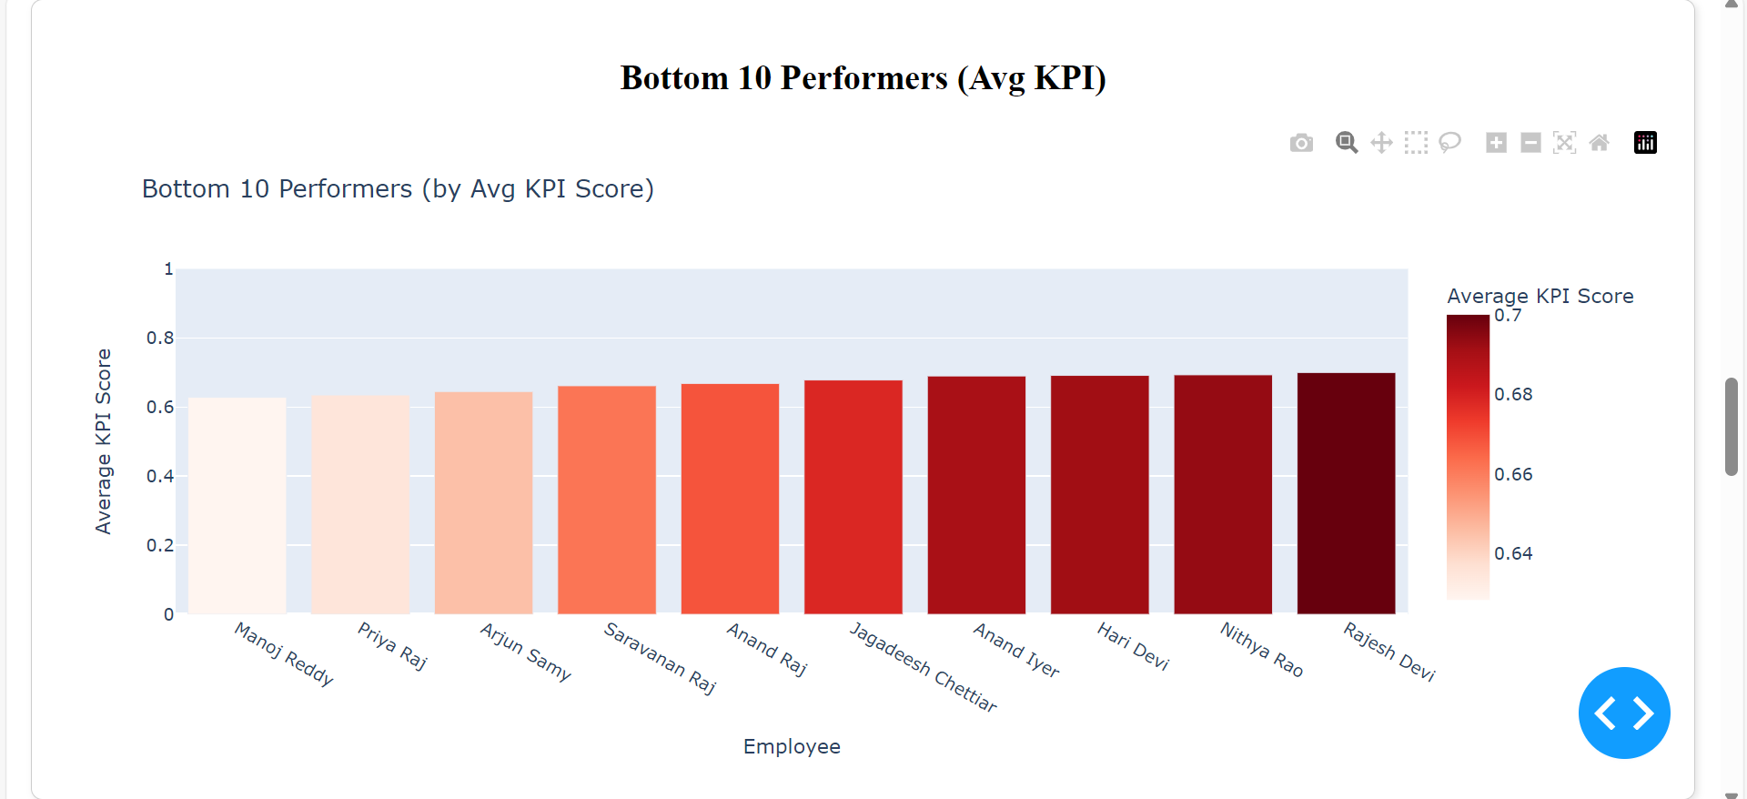
RESULTS
Bottom 10 Performers (Avg KPI)

Slide 15
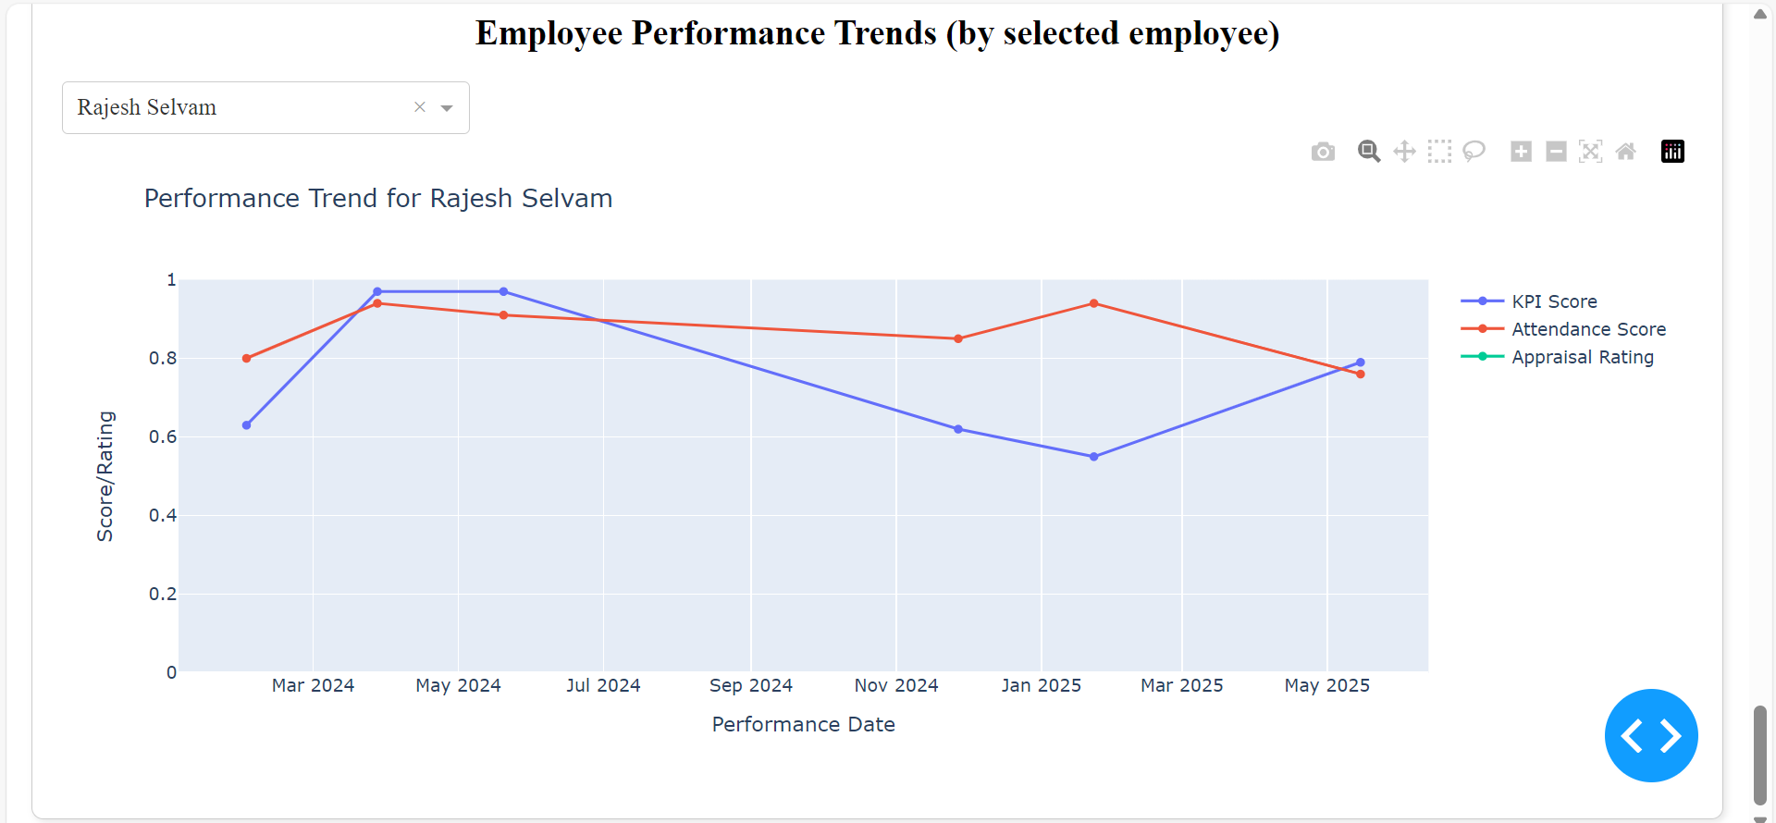
RESULTS
Employee Performance Trends (by selected employee)

Slide 16
Thank You!!

